Slide 1
Final Presentation
Comparing Approaches to Create Time Series of LMs
Md Touhidul Islam

Slide 2
Agenda
Introduction
Research Goal
Current Result
Data
Q & A
Methodology

Slide 3




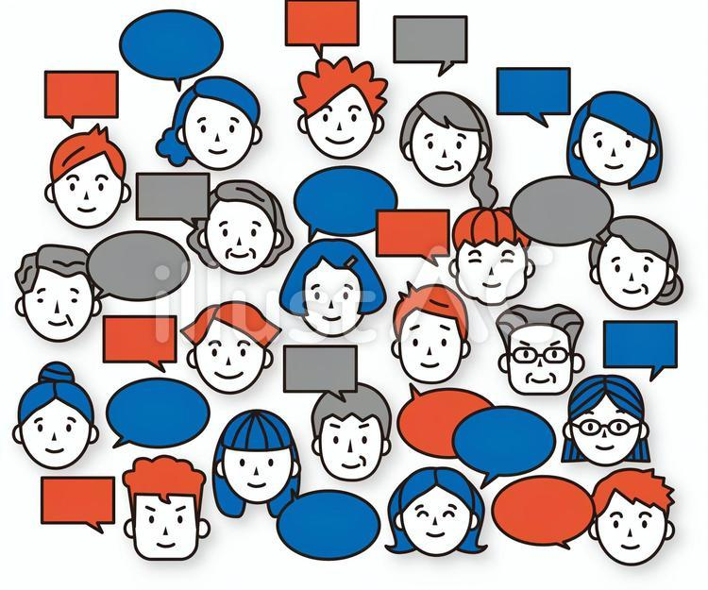


Motivation
Some question's answers get change over time.
Which political party to support?
Which product to buy?
Where should I go on holiday?
Where to invest?
Which dating app to use?
Product
Pools
Business
Politics
Some Examples
Consumer Confidence index.
Political Polls.
Approval Rating.
Business Confidence Index.
Product approval rating.
Happy
Sad
Time

Slide 4
Can we use LMs and user-generated data as a alternative
Annual Global Survey Spending (Approx.)
Market Research Surveys: 50–70 billion (includes consumer, political, and academic surveys).
Public Sector Surveys (e.g., censuses, health surveys): 10–20 billion.
Internal Corporate Surveys (e.g., employee feedback): 5–10 billion.
Total: 65–100 billion annually (pre-2023 estimates).

Slide 5
Related work
(Time series) Existing Solution
New Frontier (MTALM)
Binary Opinion analysis:
(Only Positive or Negative)
Dictionary base methods (Giachanou et al. 2016):
By counting positive or negative words surrounded by a target word.
(AFINN Lexicon, which contains more than 2,000 words, ranging from -5 to -1 for negative sentiment, and 1 to 5 for positive)
2. Sentiment-based methods:
Sentience with the target word contains a positive or negative sentiment.
Multiple Opinion Analysis:
(Happy, sad, or other emotions )
Dictionary-based methods (García et al. 2021) : Number of times the target word appears
Calculate the total number of words (Happy, sad, or other emotions )
Divide it by the total word count
2. ML-based methods (García et al. 2021) :
Models are trained to predict from a list of outcomes.
Trained on the SemEval 2018 emotion dataset (Mohammad et al., 2018).
2. The model is then run on user-generated data.
Time-aware language models:
TimeLMs (Loureiro et al. 2022): Multiple language model fine-tuned on data from a separate point of time
Research Gap: Can MTALM be used to track the change of emotion/opinion over time?

Slide 6
Research Questions:
Research Gap: Whether MTALM can be used to track the change of emotion/opinion over time?
Research Questions
Can the MTALM detect the change in people's opinions?
If MTALM can, what is the best approach to do it?
Do we need to adjust the temporal shift output?
Which similarity matrices should we use?
Can MTALM outperform existing methods?
Can MTALM outperform dictionary-based methods?
Can MTALM outperform Sentiment analysis-based methods?
Masked Time aware language model = MTALM

Slide 7




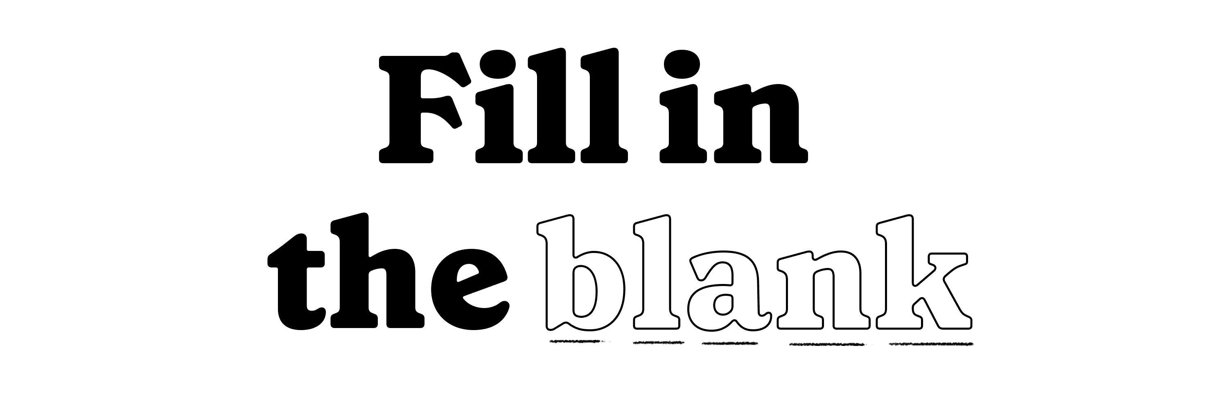
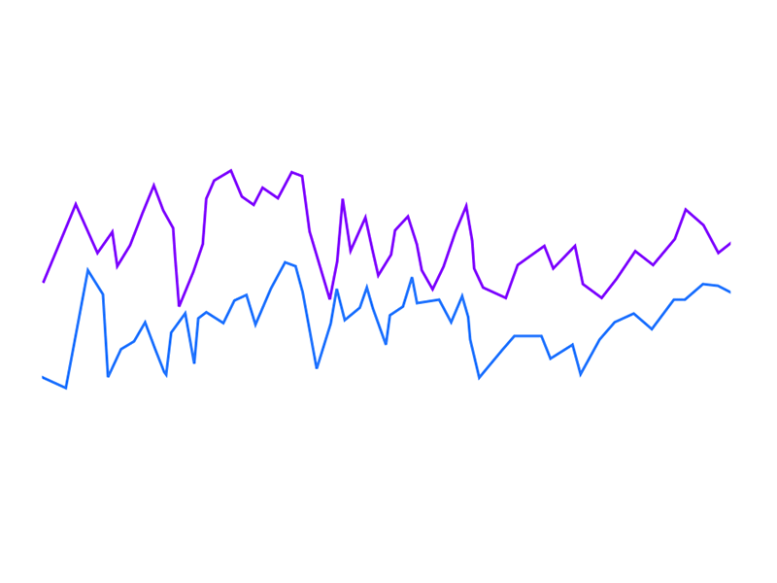
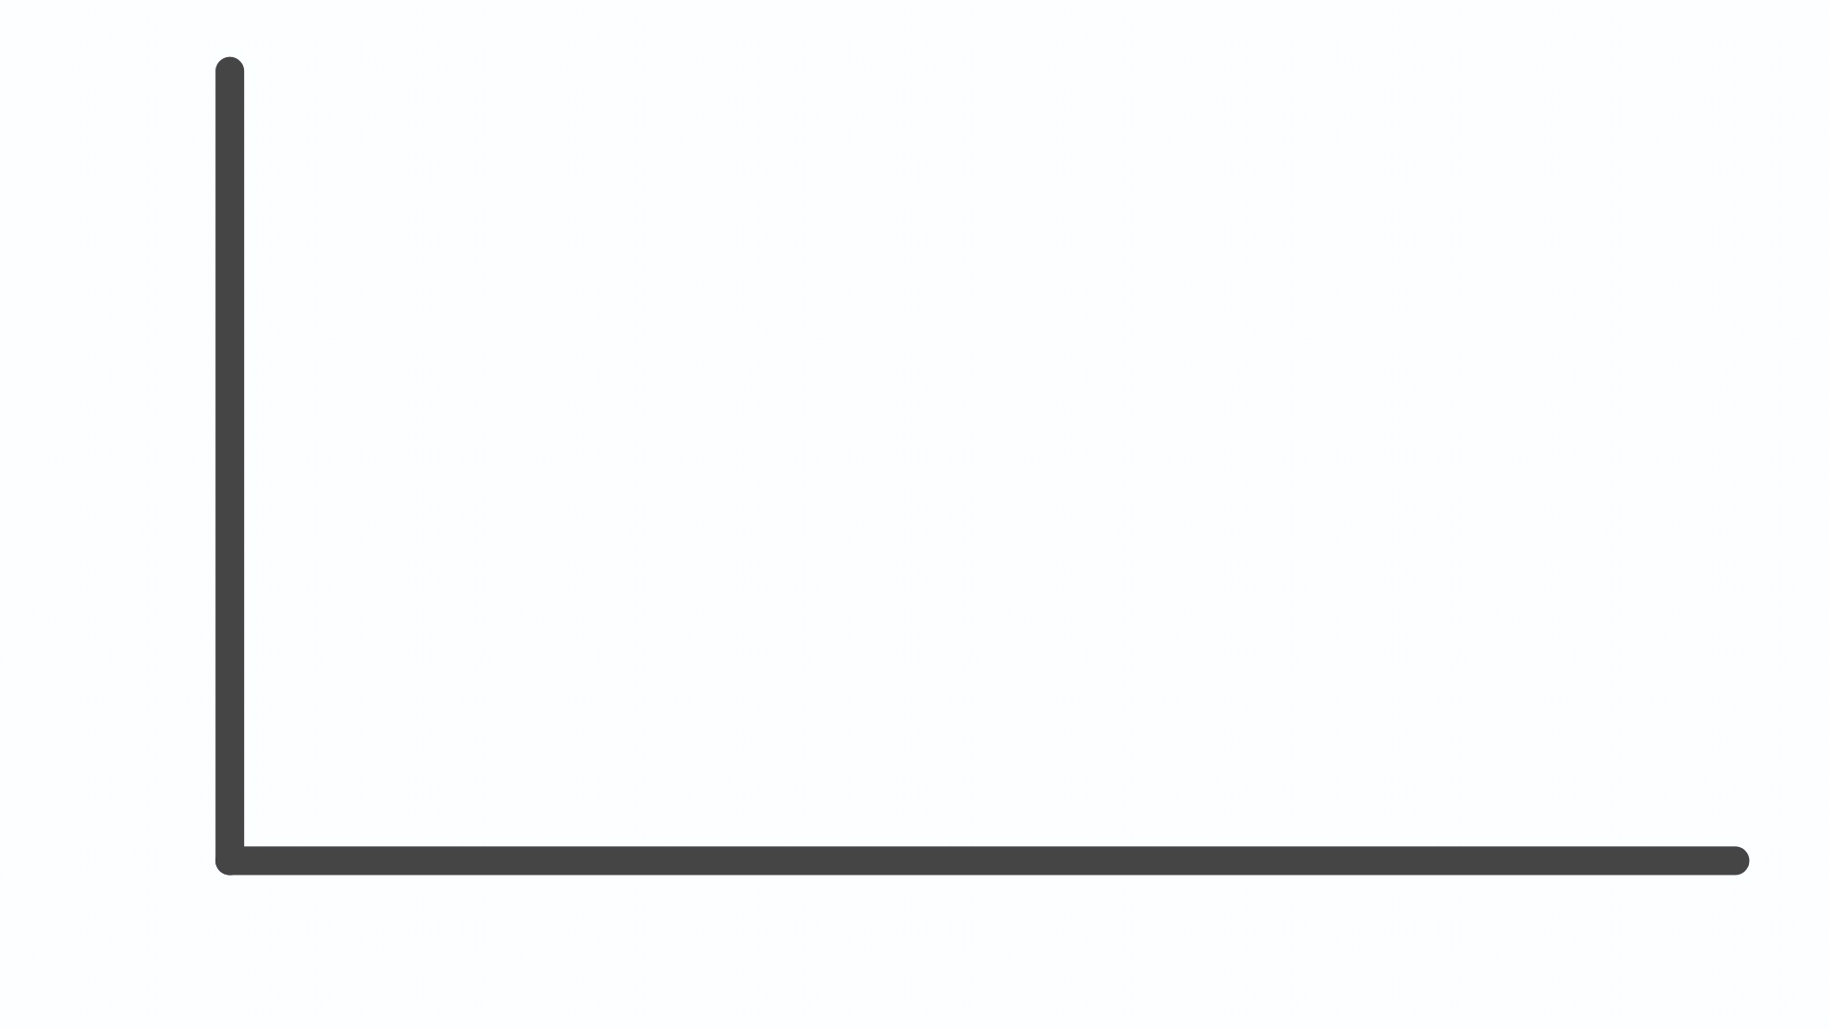

Workplan
Training
Extracting Result
Comparison
Asking the same question to all 200 models
Yougov survey result
Base Model
Pretrain Bert Model
On 850m tweets until 2019
MTALM
200 model
Tweets from 200 weeks
July 2019 – March 2023
Plotting the results on Month by month
Compare yougov result with mask model

Slide 8
Training Models
Pre-train Language Model
Stage 1: Pretrain model BERTweet was trained on 850 million English tweets collected from January 2013 to August 2019.
Data 1
Data 2
Data 4
Data 5
Stage 2: Preprocess data from all 200 different weekly tweets separately.
Data 3
Data 200
Train 1
Train 2
Train 3
Train 4
Train 5
Train 200
Stage 3: Train all 200 fresh model, each with different weekly data.
Model 1
Model 2
Model 3
Model 4
Model 5
Model 200
Stage 4: The Model has been saved on every epoch to compare

Slide 9
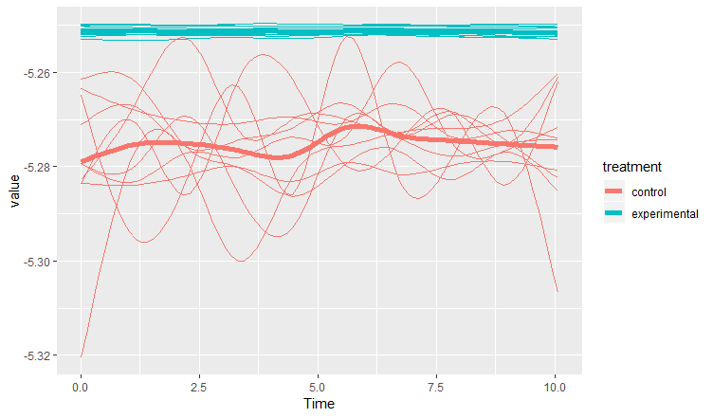
Extracting Result (How can we make it robust)
The result from the single query is heavily dependent on the query. A simple change in the question can change the result dramatically.
The season we are in currently is <mask>.
Single Question
 | Q 1 | Q 2 | Q 3 | Q 3 | Mean / Median
Happy | 14% | 23% | 43% | 25% | 26%
Sad | 25% | 34% | 34% | 23% | 29%
Joy | 23% | 45% | 45% | 21% | 34%
Scared | 21% | 34% | 34% | 23% | 28%
This time of year is considered <mask>.
Mean
Today, the season is <mask>.
Median
The current season is <mask>.
Run the same question multiple times, with different writing styles and get the average results

Slide 10
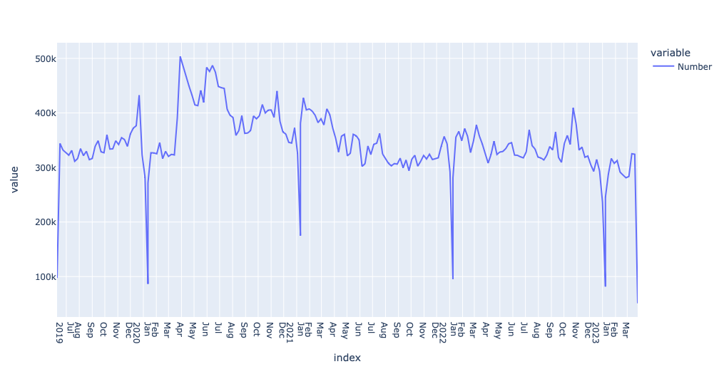
Data
The complete Twitter history of the users was extracted and split by week.
Time: UK Twitter users January 2019 – March 2023
Hight and low activity are filtered out
The data have been split into 200 weeks
Total 70 million tweets, with an average of 350 thousand weekly tweets
Keep the training data the same at 200k by under-sampling and oversampling.

Slide 11
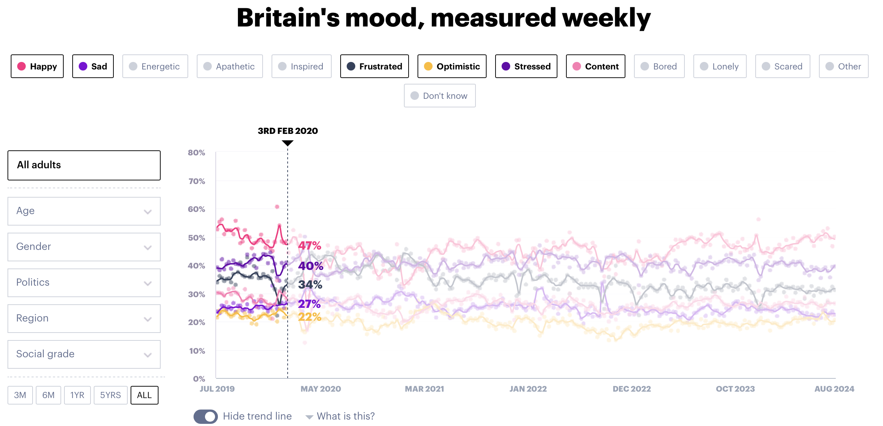
Survey Question (Gold standard)
Survey results are gathered from YouGov, which tracks the emotions and life satisfaction of the British population on a weekly basis.

Slide 12
Can it detect the change in people's opinion change?
Research question 1:
Does training give better results? Or does the base model already contain temporal information?

Slide 13
Can it detect the change in people's opinion change?
Base Model: Today is Wed, December 4th, 2021. Location UK. Which of the following best describes your mood and how you have felt in the past week? Please select all that apply <mask>.
Base Bartweet model
Ask the same question with date and Place
Results compared with Fine tuned model
Instead of
Trained model:- Which of the following best describes your mood and how you have felt in the past week? Please select all that apply <mask>.

Slide 14
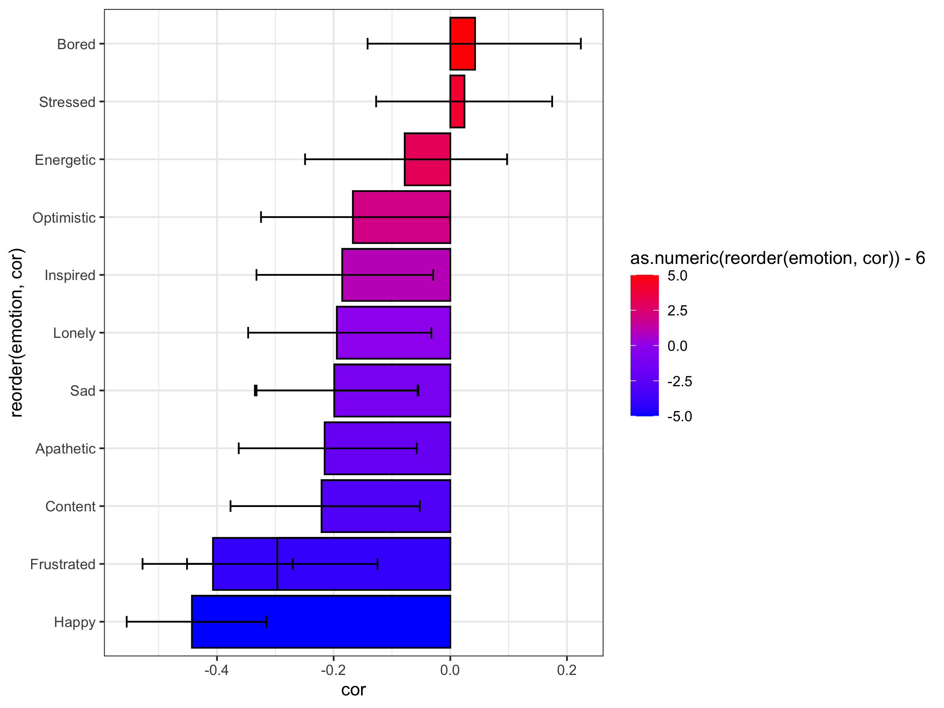
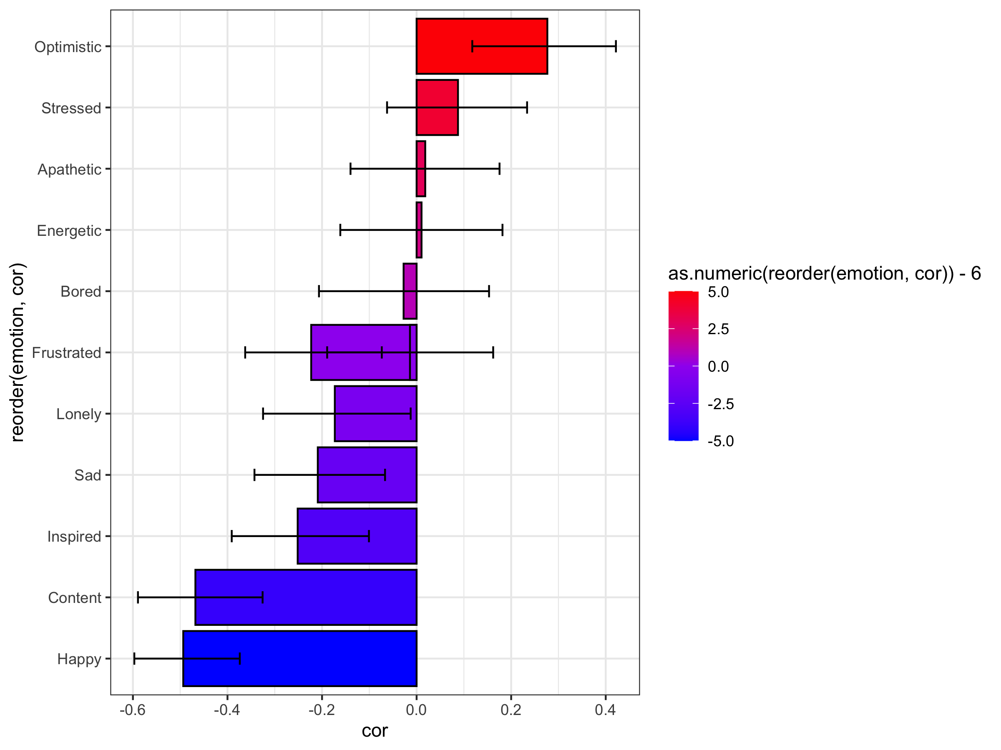
Comparing the base model with the trained model
There is overall less correlation in the base model
Critical values for a 5 % significance are also high
Base Model
Trained Model

Slide 15
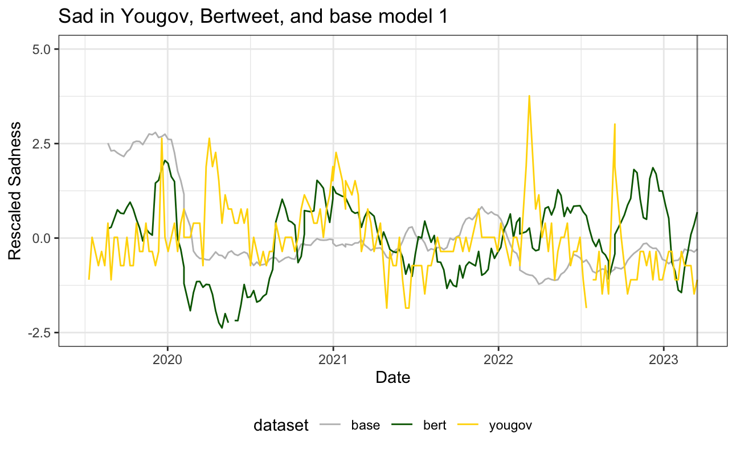
Bertweet FT vs . Baseline 1

Slide 16
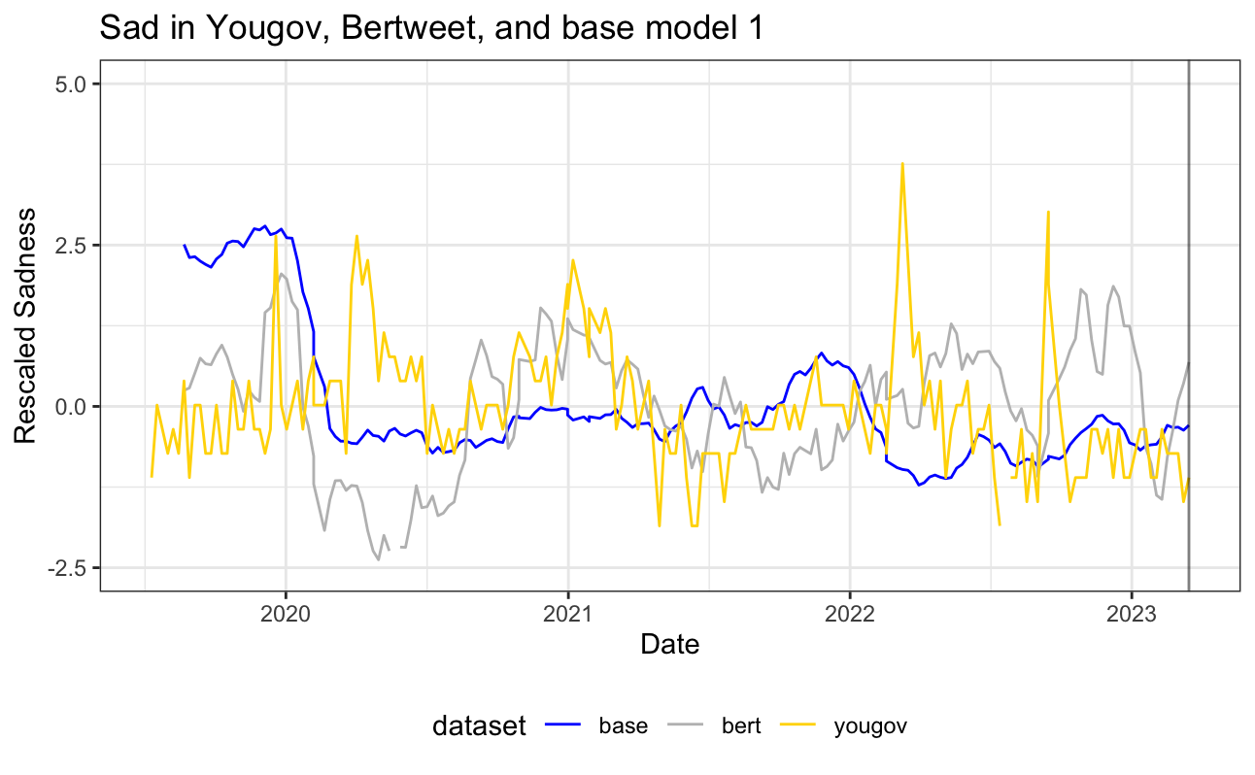
Bertweet FT vs . Baseline 1
The result for baseline 1 is almost flat

Slide 17
Bertweet FT vs . Baseline 1
Although base model 1 contains some temporal information, fine-tuning the model results in better results

Slide 18
what is the best approach to do it?
Research question 2:
Do we need to adjust the temporal shift output?
Which similarity matrices should we use?

Slide 19
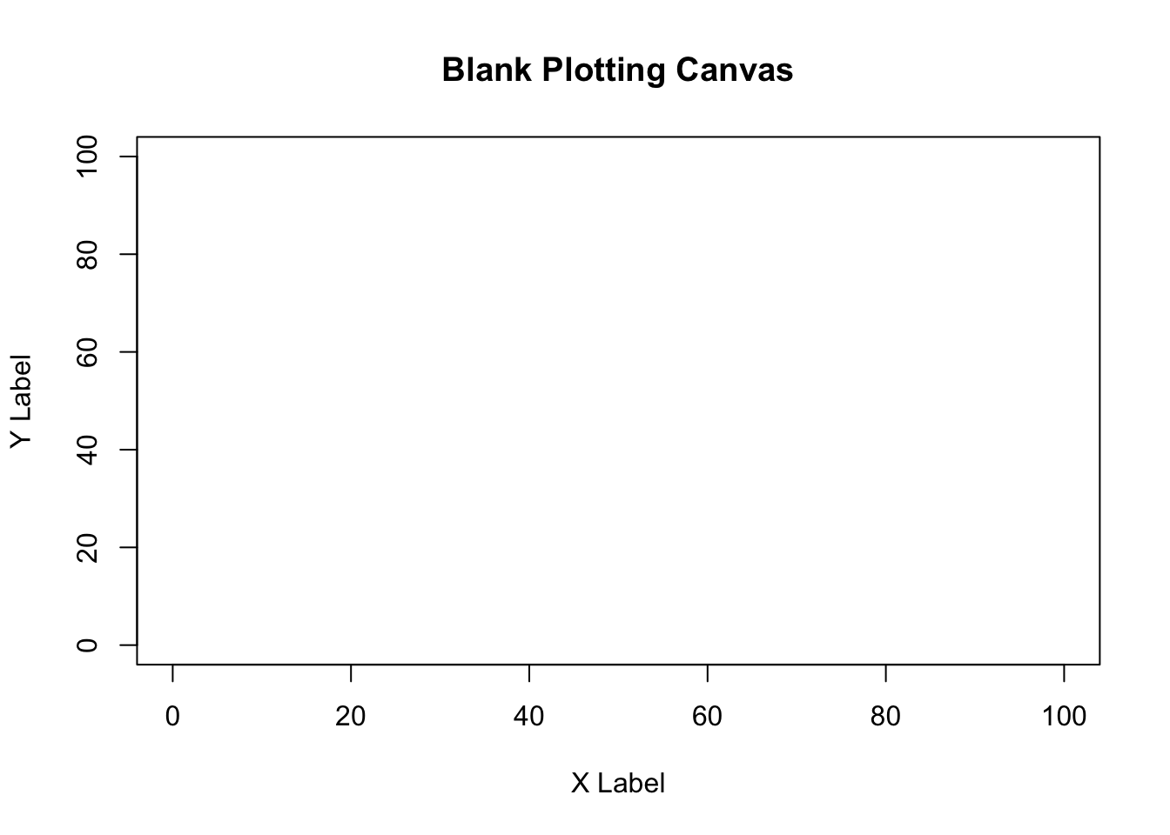
What if there is a temporal shift
LM takes some time to learn from data. So there could be a lag between the time the data is available and the time it reflects the prediction.
So, we need to check if there is any time lag, and if it is available we can adjust the result to compensate the temporal shift
Question we have asked to test it
"The season we are in currently is <mask>.",
"This time of year is considered <mask>.",
"The current season is <mask>.",
"Today, the season is <mask>.",
At the time of summer, the prediction of summer should be the height
Autumn
winter
Summer
Spring

Slide 20
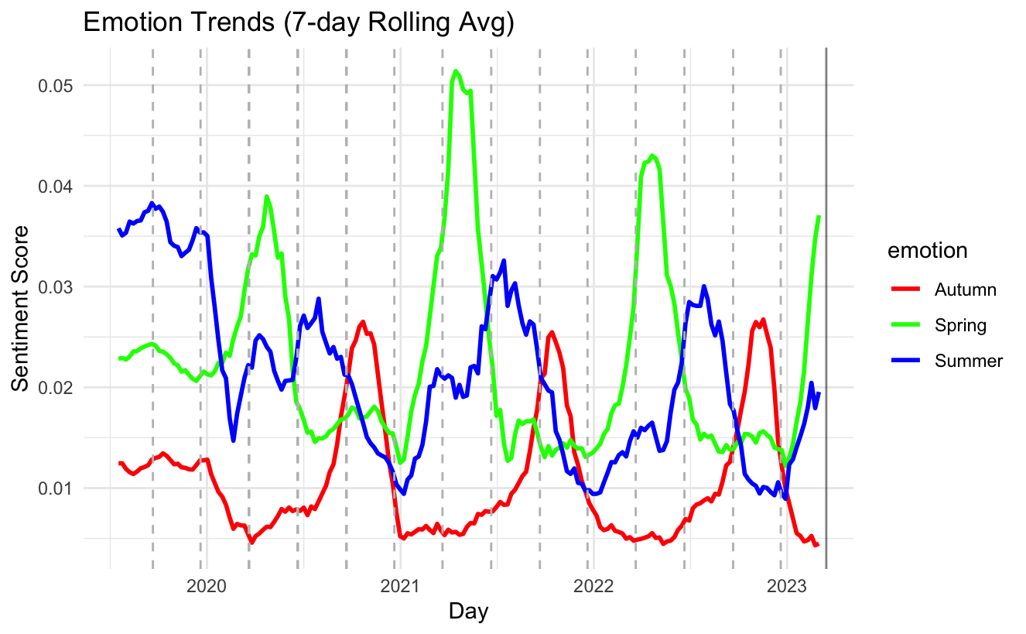
What if there is a temporal shift
Sm
Su
Wi
Sp
Sm
Su
Wi
Sp
Sm
Su
Wi
Sp
Sm
Su
Wi
1. The point of intersection, where one season transitions to another season, is almost always around the season starting date.
2. The prediction almost started to go up before starting of the season.
3. The prediction picked almost somewhere in the middle.
No Temporal shift detected

Slide 21

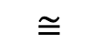
Similarity base approach
What best describes your felling today?
joyful | 0.23
glad | 0.18
cheerful | 0.144
happy | 0.09
Happy
I am feeling happy
$$≅$$
I am feeling joyful
We are throwing a lot of our data.
Tokens in the top tend to be more accurate than those in the bottom because MLM is trained to predict the first right answer.

Slide 22
Which similarity matrices should we use?
Research question 2.2:
Cosine Similarity
PANAS-X (Watson & Clark, 1994)
WordNet (Kilgarriff & Fellbaum, 2000)

Slide 23
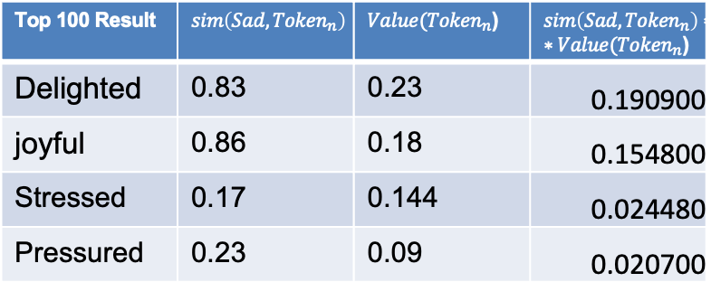
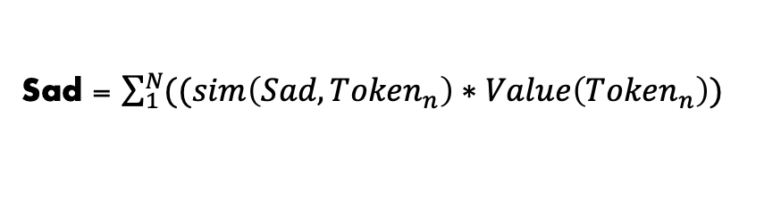
Similarity base on Cosine Similarity
Top 100 Result | $$sim\left(Sad,{Token}_{n}\right)$$ | $Value({Token}_{n}$) | $sim\left(Sad,{Token}_{n}\right)∗∗Value({Token}_{n}$)
Delighted | 0.83 | 0.23 | 0.190900
joyful | 0.86 | 0.18 | 0.154800
Stressed | 0.17 | 0.144 | 0.024480
Pressured | 0.23 | 0.09 | 0.020700
Select top n token
Calculated Similarity between 1 until n token with targeted token sad
Multiply it with the value of token n
Sum all the values to get the target value
Similarity value:
Similarity Calculation: Cosine similarity
Model:- all-MiniLM-L6-v2
Sad = $\sum_{1}^{N}{((sim\left(Sad,{Token}_{n}\right)∗Value\left({Token}_{n}\right))}$

Slide 24
Why Cosine Similarity Can Be Misleading
Focuses on Direction, Not Meaning: Measures vector angle, not semantic meaning.
Ignores Contextual Nuance: Words in similar contexts (e.g., emotions) may score high despite being opposites.
Example: Happy vs. Sad: High score (vectors point similarly due to shared context, e.g., "emotion words").
Real Life: Opposites (antonyms) with conflicting meanings.

Slide 25
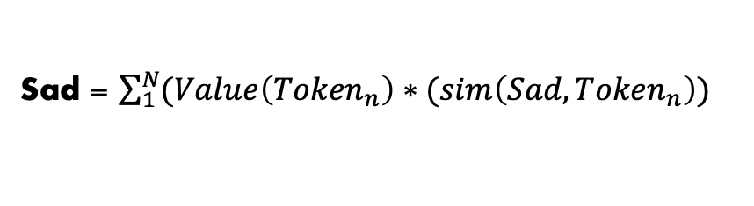
PANAS-X (Watson & Clark, 1994)
1. The PANAS-X is a validated psychological assessment tool developed to measure a broad range of emotional states.
2. The PANAS-X groups words into broader categories (Positive Affect, Negative Affect, Fear, Sadness, etc.
Emotions | Synonyms
Fear | afraid, scared, frightened, nervous, jittery, shaky
Hostility | angry, hostile, irritable, scornful, disgusted, loathing
Guilt | guilty, ashamed, blameworthy, angry at self, disgusted with self, dissatisfied with self
Sadness | sad, blue, downhearted, alone, lonely
Joviality | happy, joyful, delighted, cheerful, excited, enthusiastic, lively, energetic
Self-Assurance | proud, strong, confident, bold, daring, fearless
Attentiveness | alert, attentive, concentrating, determined
For every word, the similarity score is 1
So, we skip the multiplication part. Directly sum the Result together
Sad = $\sum_{1}^{N}{(Value\left({Token}_{n}\right)∗(sim\left(Sad,{Token}_{n}\right))}$

Slide 26
PANAS-X
Critical values for a 5 % significance

Slide 27
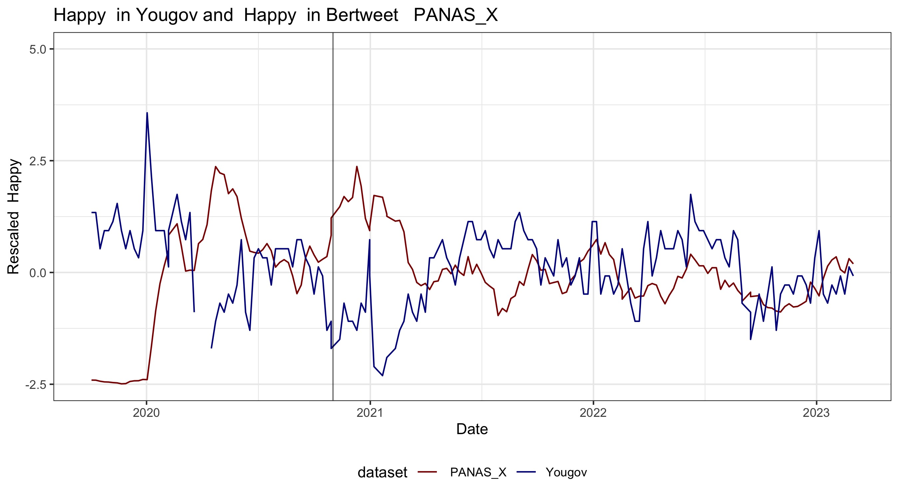
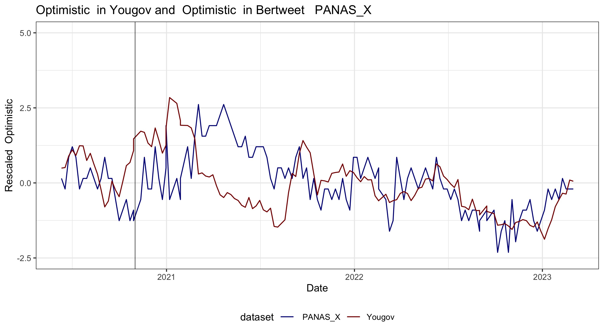
PANAS-X

Slide 28
Problem with PANAS-X
Only limited to few vocabulary, and only sentiment related question.
If we want to use our methods for example question related to political questions it is not going to work.
So, we want to find a solution where the similar words are defined automatically and can be use different question.

Slide 29
Similarity base on WordNet (Kilgarriff & Fellbaum, 2000)
Lexical Database: Organizes words into synsets (synonym groups) with semantic relationships (e.g., antonyms, hypernyms, hyponyms).
Human-Curated: Relationships are manually defined, not learned from data.
Explicit Antonym Links: Marks happy and sad as direct antonyms (opposites).
Semantic Hierarchy: Captures broader/narrower meanings (e.g., happy → joyful, sad → gloomy).
Word Pair | Cosine Similarity | WordNet Relationship
Happy vs. Sad | High (shared context) | Antonyms (opposites)

Slide 30
Similarity base on WordNet
Critical values for a 5 % significance

Slide 31
Can this approach outperform existing methods?
Research question 3:
Can it outperform dictionary-based LIWC- Linguistic Inquiry and Word Count, (García et al., 2021)) methods?
Can it outperform Sentiment analysis methods based on RoBERTa (García et al., 2021)
methods?

Slide 32
Bertweet FT vs . Baseline 2
LIWC (Linguistic Inquiry and Word Count, García et al., 2021)
Tweets are separated by weeks: tweets are aggregated into weekly
Week 1 | T1, t2, t3, t4, t5…
Week 2 | T1, t2, t3, t4, t5…
Week 3 | T1, t2, t3, t4, t5…
Word Counting: The input text is processed by counting the occurrences of words that belong to each category in the LIWC dictionary.
 | Happy | Sad | Joy | Scared | Total
Week 1 | 14 | 25 | 23 | 21 | 102
Week 2 | 23 | 34 | 45 | 34 | 105
Week 3 | 43 | 34 | 45 | 34 | 120
Percentage Calculation: The raw word counts are then converted into percentages, representing the proportion of words in the text that fall into each category.
 | Happy | Sad | Joy | Scared
Week 1 | 14% | 25% | 23% | 21%
Week 2 | 23% | 34% | 45% | 34%
Week 3 | 43% | 34% | 45% | 34%
(Number of words in category / Total number of words in text) * 100%

Slide 33
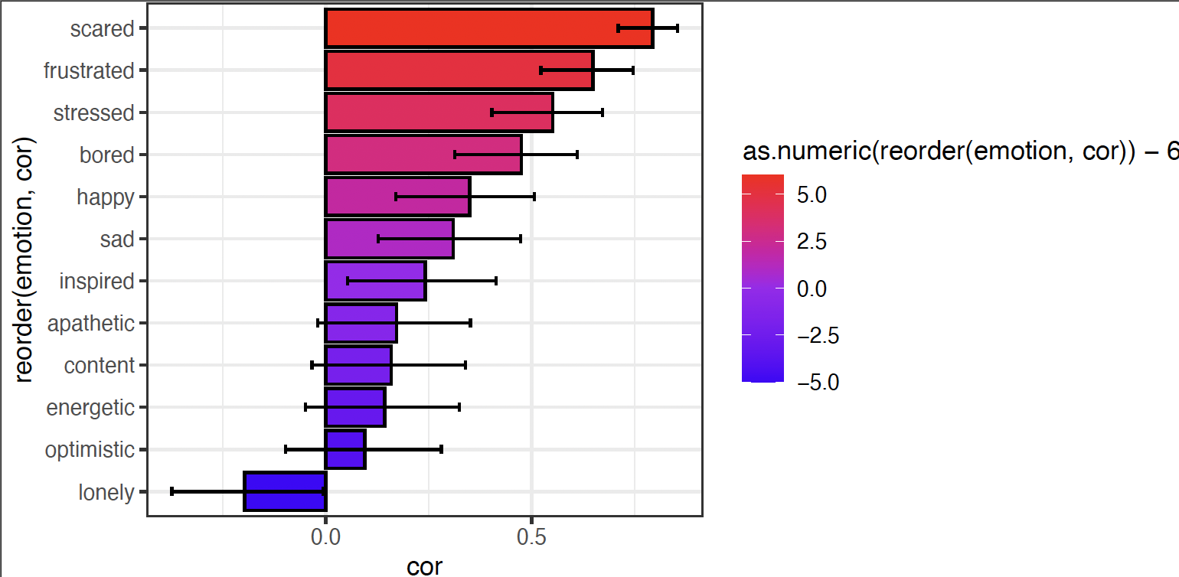
Compare with Base Model 2 Dictionary base methods
Dictionary
MTALM Model
Critical values for a 5 % significance

Slide 34
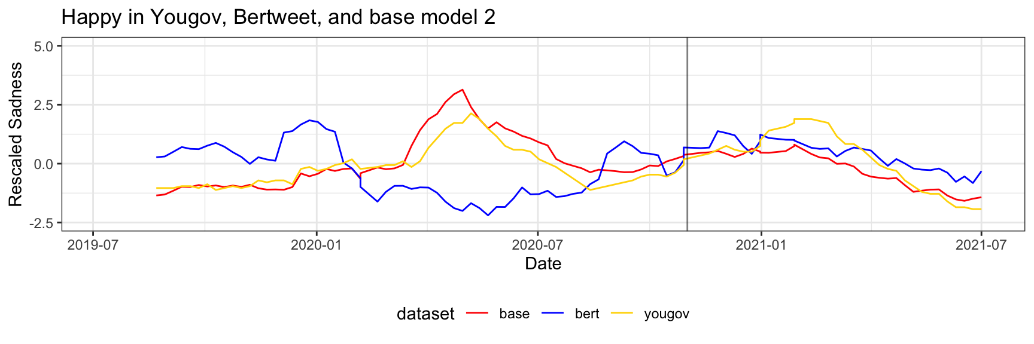
Bertweet FT vs . Baseline 2
Where Bertweet fails to match GS,
Baseline 2 performs surprisingly well

Slide 35
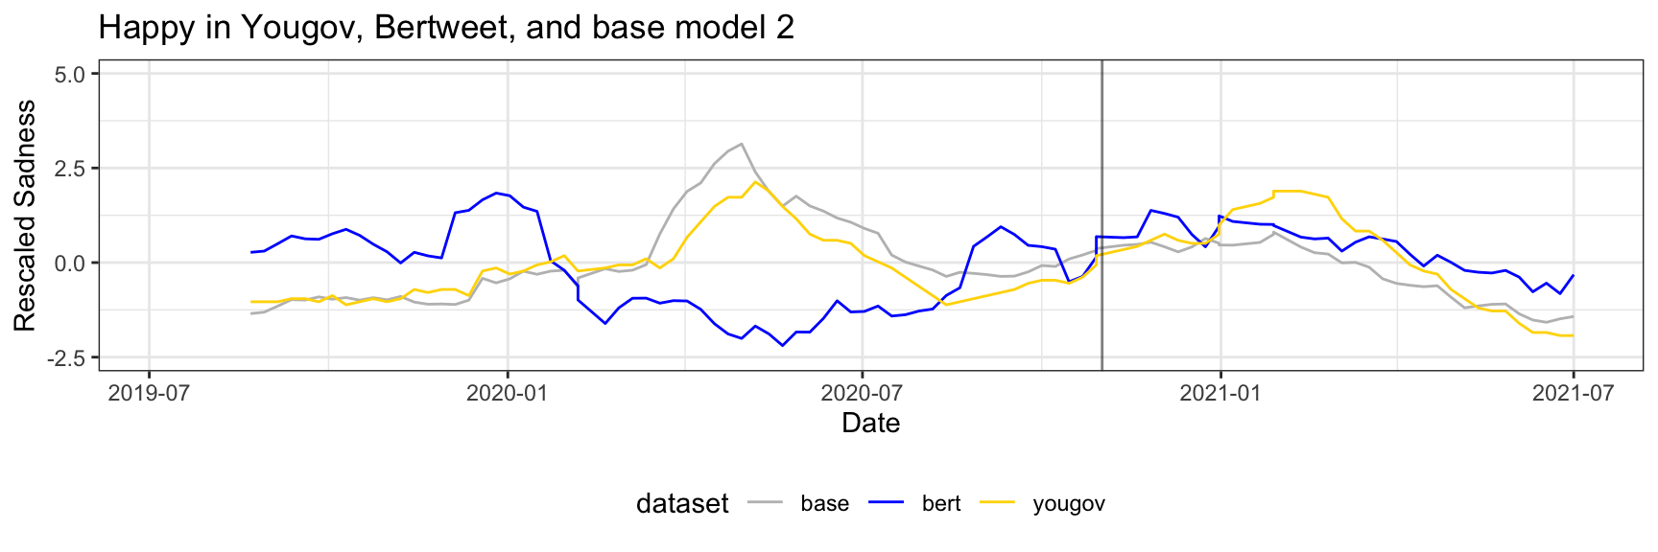
Bertweet FT vs . Baseline 2

Slide 36
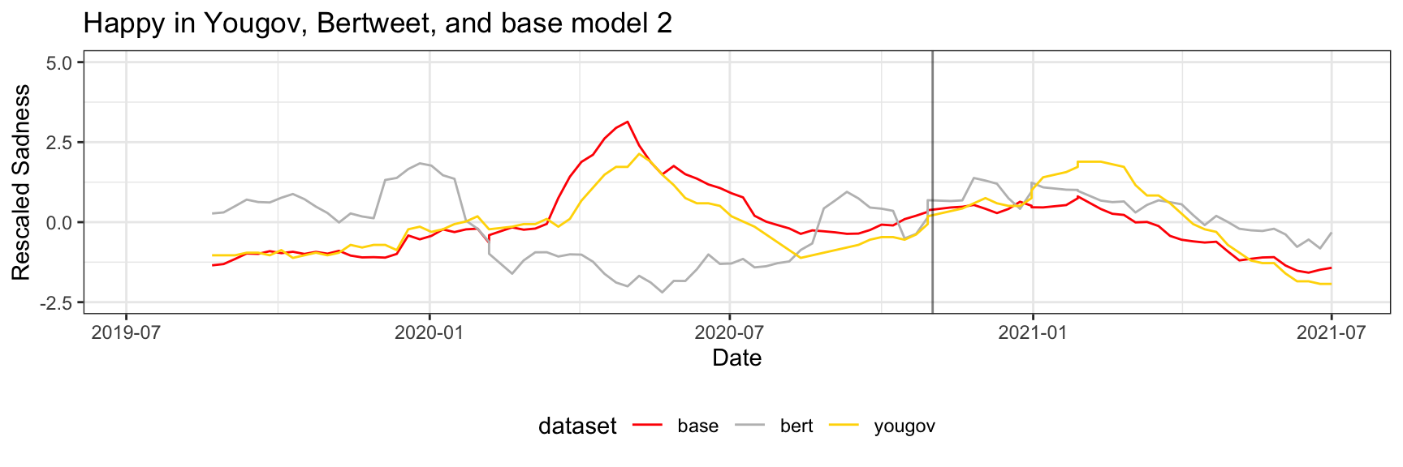
Bertweet FT vs . Baseline 2
Baseline 2 almost perfectly aligns with GS

Slide 37
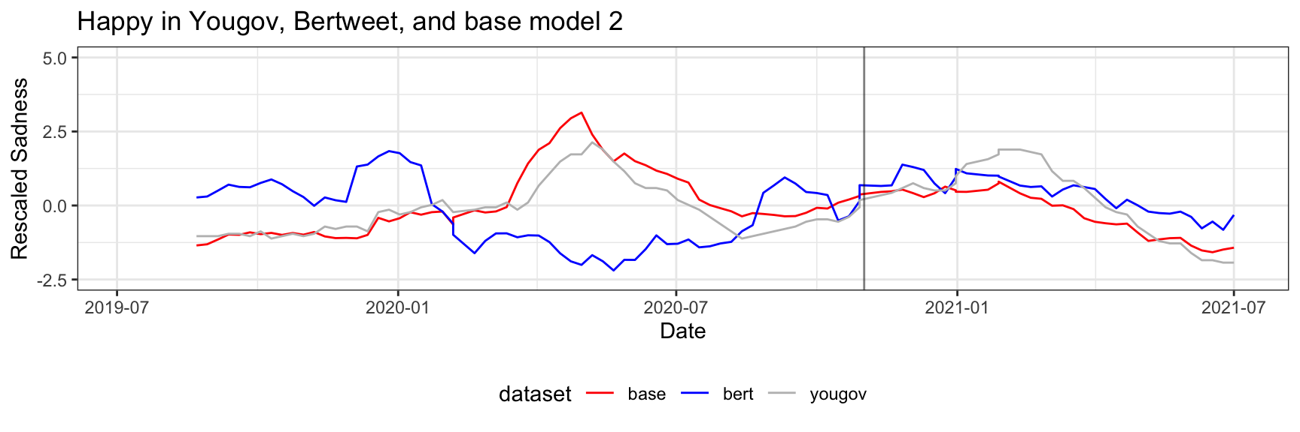
Bertweet FT vs . Baseline 2

Slide 38
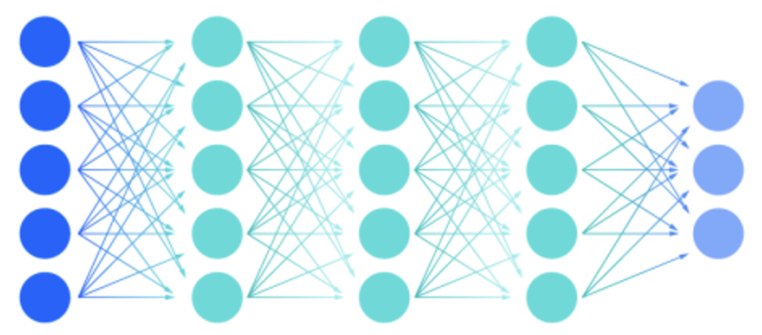
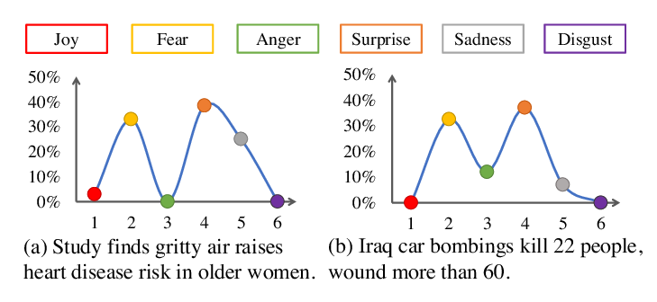
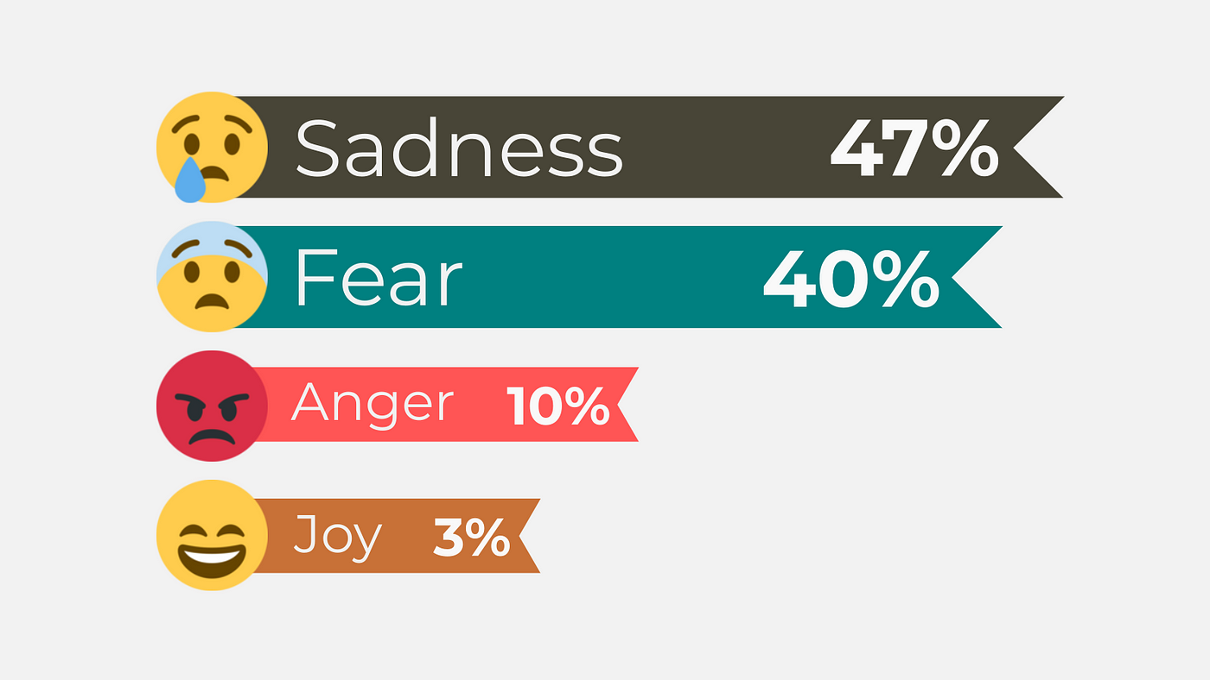
Emotion macroscope - RoBERTa (García et al., 2021)
Model: Take the RoBERTa-base language model and add a layer to the deep neural network.
Sadness
Fear
Joy
Supervised Training: The model is trained on the SemEval 2018 emotion dataset (Mohammad et al., 2018).
SemEval 2018: 1,400 tweets per emotion (anger, fear, joy, sadness)
Calculate sentiment: Three emotions of interest for our study: sadness, fear, and joy. Calculate the score for each tweet
Aggregated to estimate the overall sentiment for a given period
Value = ∑(Sentiment score of all tweets containing target word)

Slide 39
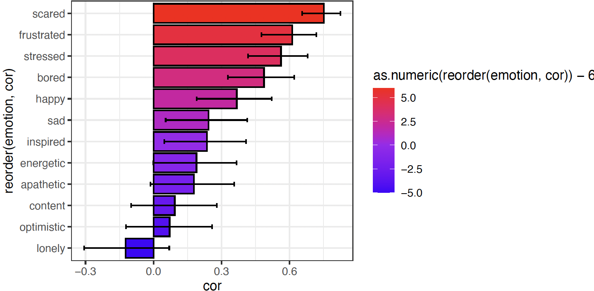
Bertweet FT vs . Baseline 3
Roberta
MTALM Model

Slide 40
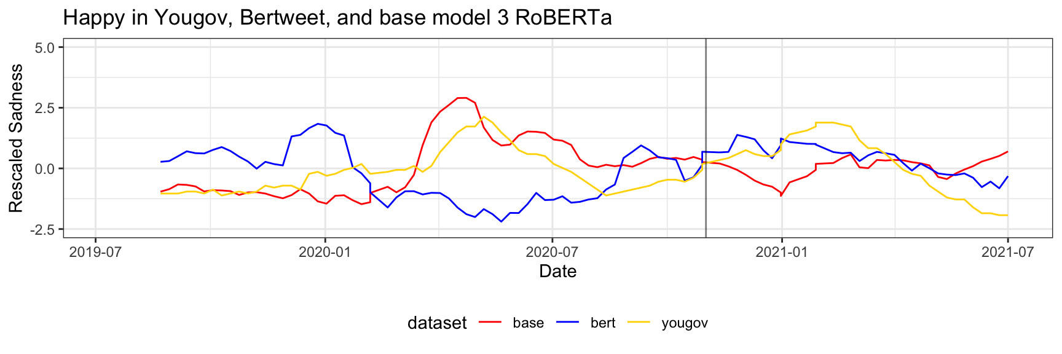
Bertweet FT vs . Baseline 3
Baseline 3 also almost aligns with GS

Slide 41
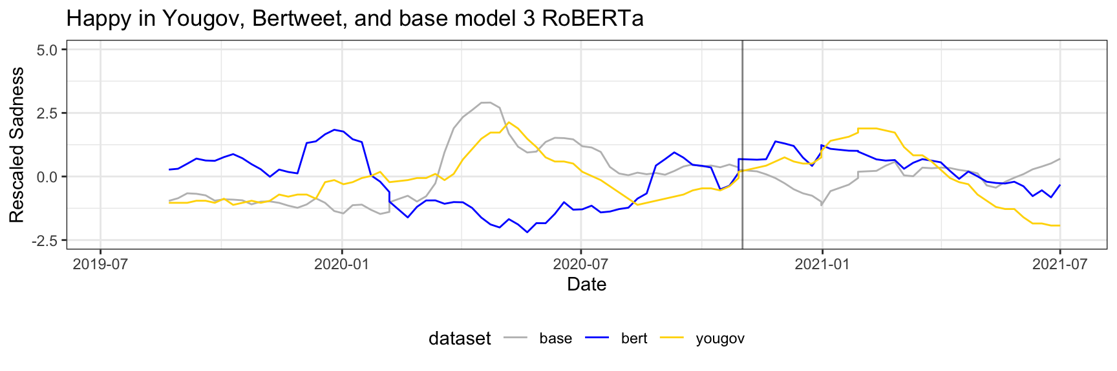
Bertweet FT vs . Baseline 3

Slide 42
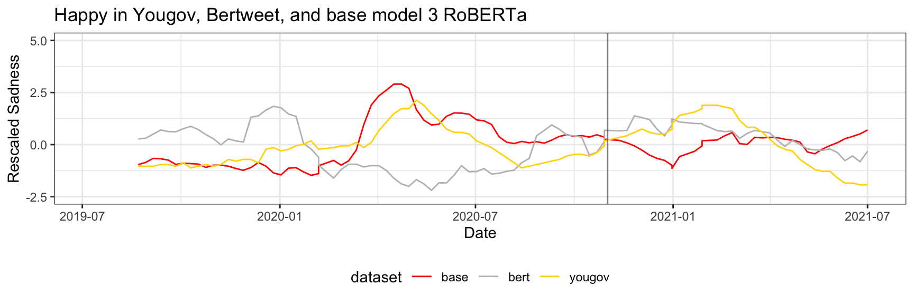
Bertweet FT vs . Baseline 3
Tends hard to spot due to high volatility and value predominantly stay in the middle

Slide 43
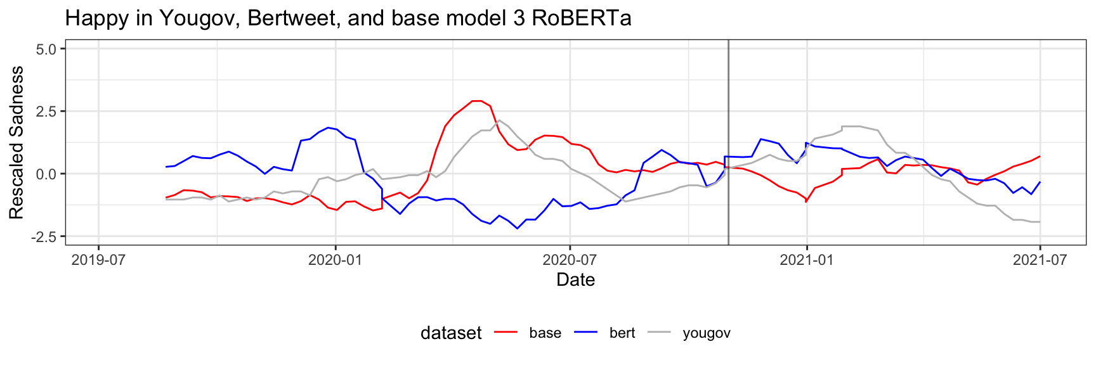
Bertweet FT vs . Baseline 3

Slide 44
Conclusion
Although MTALM can predict some emotions, it has failed to beat existing solutions like dictionary-based and sentiment-based methods.
Mask models are trained to predict one word with height probability, but it is not trained to match the probability with a real word.
Making the model perform consistently and repeatably is still a challenge.
The variation between results from one emotion to another is still high. Even with the existing solution.
Future Work
A newer language and bigger Language model can be used.
Contextual language models (CLMs) can be used by passing weekly tweets as a context instead of training multiple models.

Slide 45


Slide 46
Reference
References
Beasley, A., Mason, W., & Smith, E. R. (2016). Inferring emotions and self-relevant domains in social media: Challenges and future directions. In A. Beasley, W. Mason, & E. R. Smith, Translational Issues in Psychological Science (Vol. 2, Issue 3, p. 238). American Psychological Association. https://doi.org/10.1037/tps0000086
García, D., Pellert, M., Lasser, J., & Metzler, H. (2021). Social media emotion macroscopes reflect emotional experiences in society at large. In D. García, M. Pellert, J. Lasser, & H. Metzler, arXiv (Cornell University). Cornell University. https://doi.org/10.48550/arxiv.2107.13236
Mohammad, S. M., Bravo-Márquez, F., Salameh, M., & Kiritchenko, S. (2018). SemEval-2018 Task 1: Affect in Tweets. https://doi.org/10.18653/v1/s18-1001
Home. ESOMAR. (n.d.-a). https://esomar.org/
Watson, D., & Clark, L. A. (1994). The PANAS-X: Manual for the Positive and Negative Affect Schedule - Expanded form [Dataset]. https://doi.org/10.17077/48vt-m4t2
Kilgarriff, A., & Fellbaum, C. (2000). WordNet: an Electronic Lexical Database. Language, 76(3), 706. https://doi.org/10.2307/417141

